Slide 1

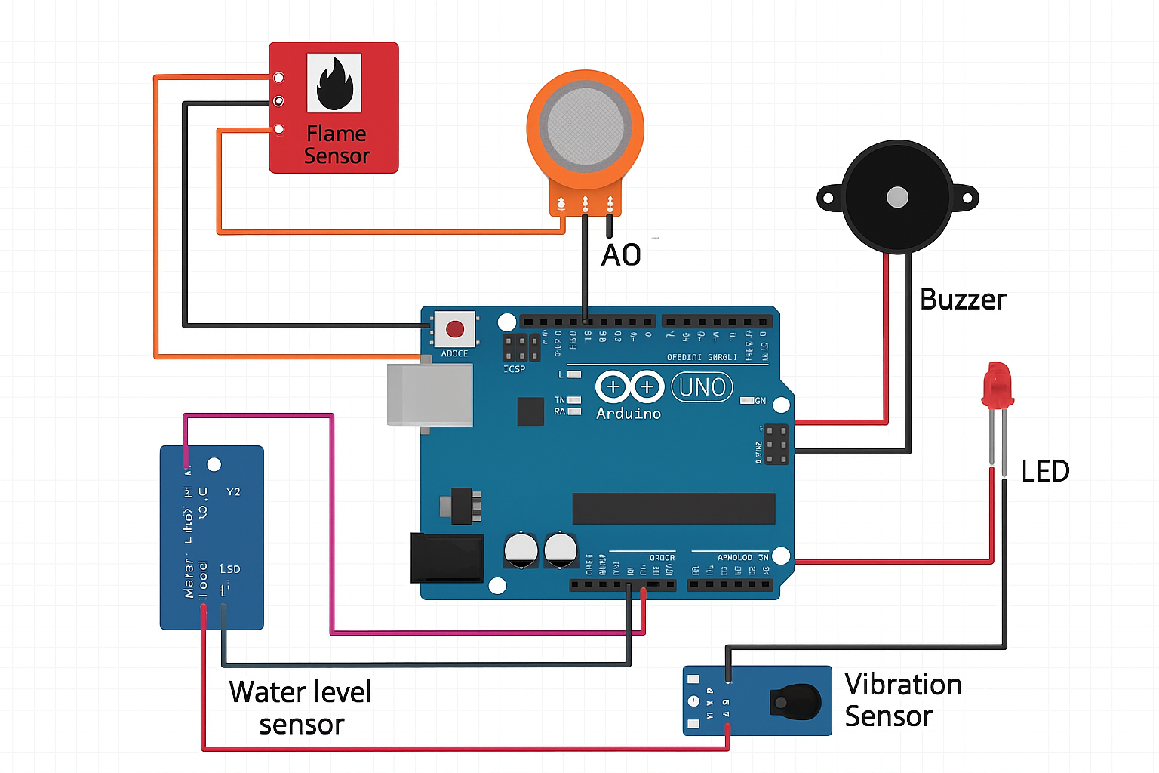
RV College of Engineering, Bengaluru – 560059.
Go, change the world
Arduino-Based Multi-Sensor Hazard Monitoring and Early Warning Unit
^{V}
IDEA LAB SEE Project - I SEM
Branch:Aerospace
Section:
Ankith Joshi| Shreyas M|Ramanuja A K|Mithun V Y
RVCE25BAS051|RVCE25BAS058|RVCE25BAS046|RVCE25BAS038 Mentor Name 1 Mentor Name 2
Quantitative Results
Fire Sensor: The flame sensor registered the presence of an open flame within fractions of a second at close range.
Gas Sensor:MQ-135 outputs required the standard warm-up (stabilization) time; after warm-up the module detected concentration changes reliably
Water-level sensor: The water-level sensor worked as expected, When the water level rose above a certain pre-defined threshold limit, A alert was triggered to warn the rise in water-level
Vibration Sensor: SW-420 reliably toggled its digital output on light taps and stronger shakes.
ALERTING
The hazard detection system activated the specific LEDs and the Buzzer almost instantly for the flame and vibration sensor but was slightly delayed for the Gas and Water-level sensor based on speed on immersion
The project is successfully tested and validated for alerting of disasters like earthquake,flood,volcanic eruption,etc.The project successfully detects the flame,changes in concentration,water lever and the vibrations for predicting disaster and noticing it.
The measurable outcomes for a multi-sensor hazard monitoring and early warning unit encompass three critical areas: System Efficiency, Warning Effectiveness, and Impact Reduction. The ultimate success is measured by Impact Reduction, specifically the proven increase in Community Response Compliance Rate (e.g., >80\% of people taking recommended action) and the quantifiable decrease in Injuries, Fatalities, and Economic Losses directly attributable to the system's timely warnings.
F. M. Mims, Electronic Sensor Circuits & Projects, Newnes, USA, 2007.
D. Patranabis, Sensors and Transducers, 2nd ed., PHI Learning, New Delhi, India, 2010.
R. K. Rajput, Sensors and Control Systems in Engineering, S. Chand & Company, New Delhi, India, 2014.
A. Sharma and R. Kumar, “Arduino-Based Fire Detection and Alarm System,” International Journal of Engineering Research & Technology (IJERT), vol. 8, no. 6, pp. 245–249, 2019.
R. Suresh and J. Thomas, “Arduino-Based Flood Monitoring and Alert System,” International Journal of Scientific Research in Engineering and Technology, vol. 10, no. 4, pp. 89–93, 2021.
Introduction
Results & Discussions
Disasters such as fire accidents, toxic gas leakage, flooding, and unexpected structural vibrations continue to pose major risks in both domestic and industrial environments. These hazards often occur without warning and can escalate rapidly, causing significant damage to property and endangering human life.So the system incorporates dedicated sensors for each hazard and provides instant alerts through visual indicators and audible alarms
Objectives
This project aims to design and implement an Arduino-based Multi-Hazard Early Warning and Alert System that can simultaneously detect fire, hazardous gases, rising water levels, and abnormal vibrations.Main objective to to provide a safe living to our beloved citizens.
Methodology
Water Level Detection
Water levels in the containment vessel were raised gradually. With each incremental rise of the water level, the sensor registered an increase in the sensor output, and the buzzer sounded an alarm when the threshold was exceeded. An SMS message was created.
Vibration Detection
To simulate the effects of minor vibrations the sensor was subjected to gentle tapping and gentle shakes. Each time a gentle tap/shake was applied to the sensor, it was easily detected as sudden movement by the vibration sensor. As a result, the Arduino was activated and generated an alert.
Humidity and Temperature Detection
The sensor was placed into a warmer area and subsequently into a cooler area. There were corresponding changes in temperature and humidity output from the sensor for each test.
Testing/Validation & Feedback
  Software Implementation
Arduino IDE
Arduino IDE supports C/C++-based programming and allows you to upload code and monitor the serial output in real time.
Sensor Data Reading
Each sensor value is read periodically; fixed threshold values are defined for water level, vibration, temperature, Fire and humidity. When an individual reading passes the threshold value(s), the system enters alert mode.
Alert Logic
Flood alert if water level rises above threshold; earthquake alert if there is a spike in vibration; weather alert if temperature/humidity levels are above normal.
Measurable Outcomes
Empirical, Calculations, Tools & Techniques
References
1.Arduino UNO
2.Water Level Sensor
3.Vibration Sensor (SW-420)
4.Temperature & Humidity Sensor (DHT11/DHT22)
5.Buzzer and LED Indicators
6.Power Supply
A 9V battery or USB power is used to power Arduino and sensors.
QR codes
QR Code of Demonstration of the prototype /design simulation
QR Code of
Project POSTER
QR Code of
Project REPORT
2024-2025

